Slide 1
Optimizing Candidate Selection
Semester Long Project with Machine Learning and Data Science Club
@Baruch College
Notes:
Natia
Hello,

Slide 2
Agenda
Team Introduction
Project Overview and Background
Introduction to the Data
Data Cleaning and Preprocessing
Modeling and Evaluation
Conclusion
Next Steps
Notes:
Kevin

Slide 3







Team Introduction
University Logo
MLDS Team
Baruch Team
Natia Burjanadze
Efe Albayrak
Willy
Vice President of Tech & Project Manager
Student
Student
Kevin De La Cruz
Student
Jae Choi
Student
Lacy Lin
Student
Notes:
Everyone

Slide 4
Project Overview and Background

Slide 5
“
Project Purpose
The challenge is to build an open source candidate selection AI model to help Baruch organizations automatize and improve their hiring process.
______
Notes:
Jae

Slide 6
Challenges:
Candidate selection processes can be time-consuming and resource-intensive for Baruch organizations.
Biases, both conscious and unconscious, can influence hiring decisions, leading to a lack of diversity and inclusion in the workforce.
Traditional resume screening methods may overlook qualified candidates who do not fit conventional criteria or who have unconventional career paths.
Identifying the right candidate from a large pool of applicants can be daunting and prone to human error.
Solution:
Developing an AI-powered candidate selection model can streamline and optimize the hiring process Implementing machine learning algorithms can help mitigate biases by focusing solely on candidate qualifications and skills.
Utilizing natural language processing (NLP) techniques can enable the extraction of relevant information from resumes and other candidate documents, facilitating a more comprehensive evaluation.
Notes:
Kevin

Slide 7
Introduction to the Data

Slide 8
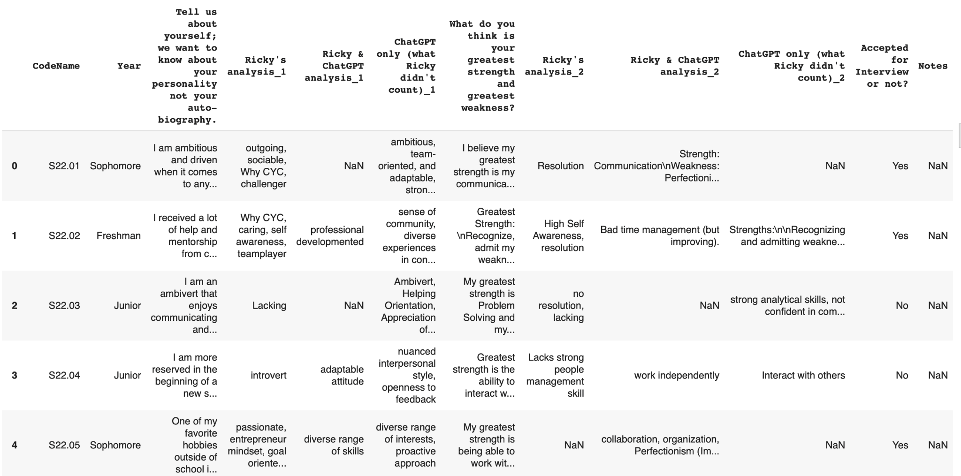
Data
The data set comes from Baruch Organization - CYC club.
Notes:
you will need to describe features and talk about label. Also, explain how data was altered by manager by adding manually sentiment analysis.
Export the data (panda).
When
Independent feature: anything else, ex: tell us about yourself (provide by the individual)
Dependent feature (label): accepted for interview
We have the almost 200 rows, that’s the
Note:
Data size
Data Source
Features
Data Scarcity
Sample Bias

Slide 9
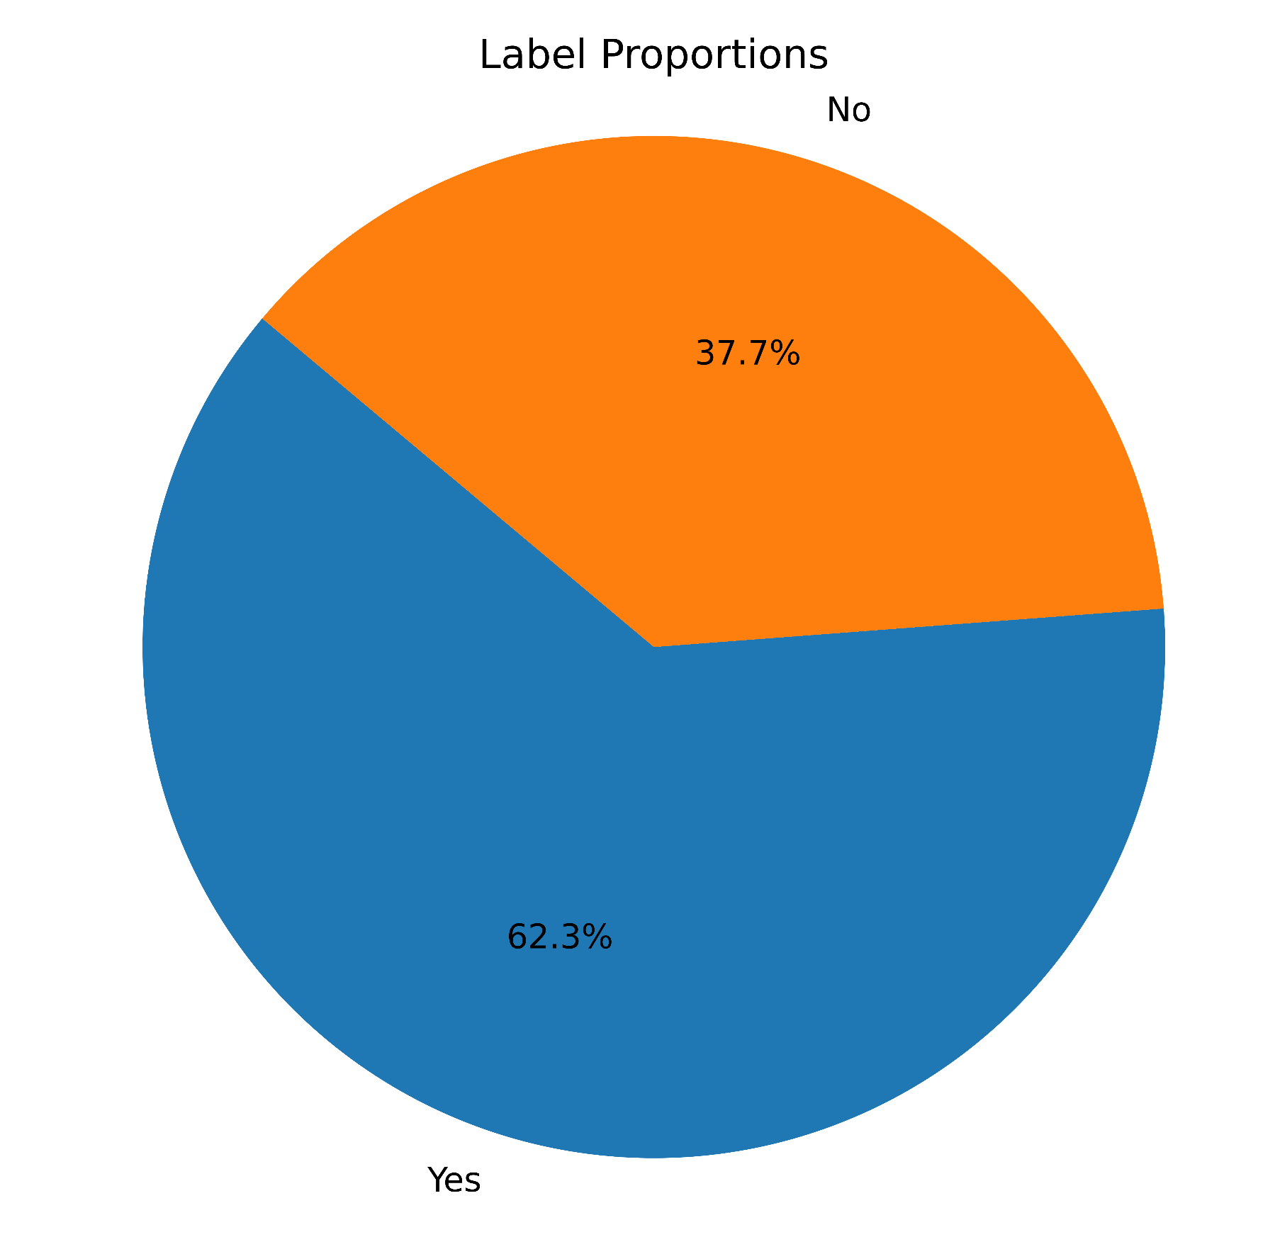
Accepted vs Declined the interview in Data
Notes:
Lacy
Pie chart: there are twice more higher acceptance rate than rejection rate

Slide 10
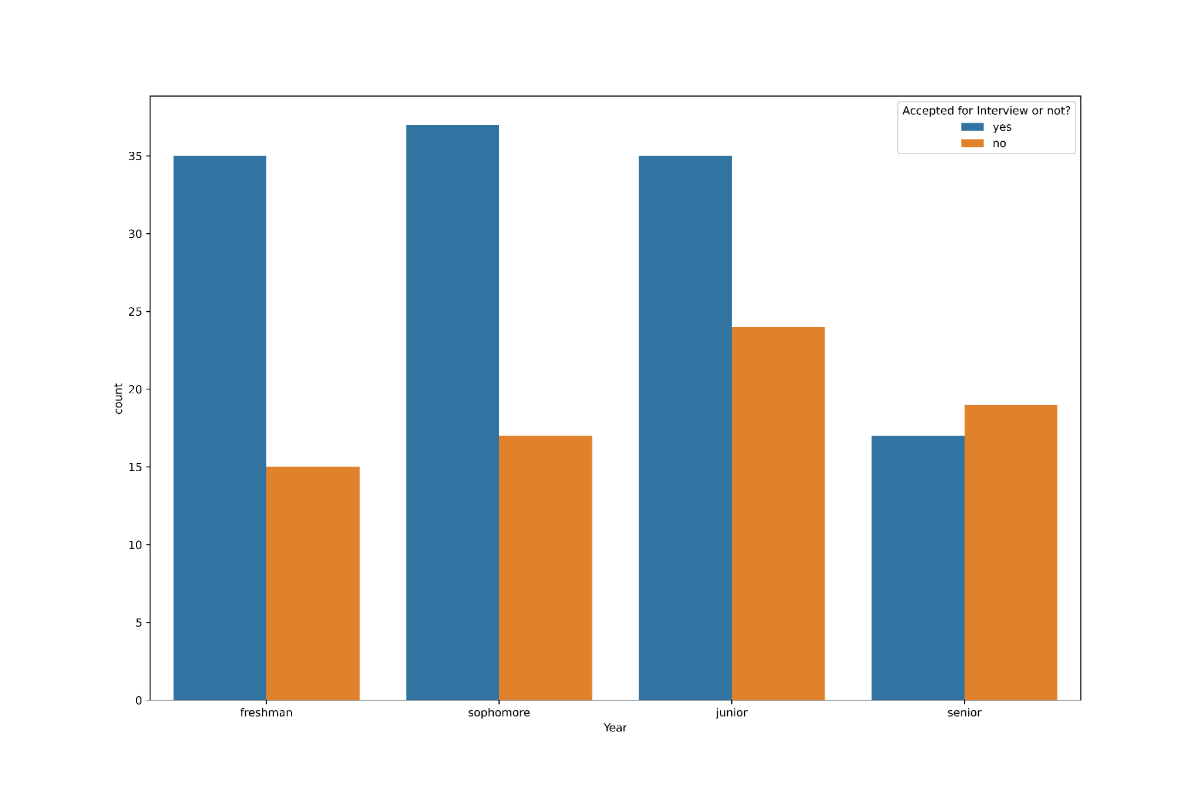
Student’s Year Vs Acceptance

Slide 11
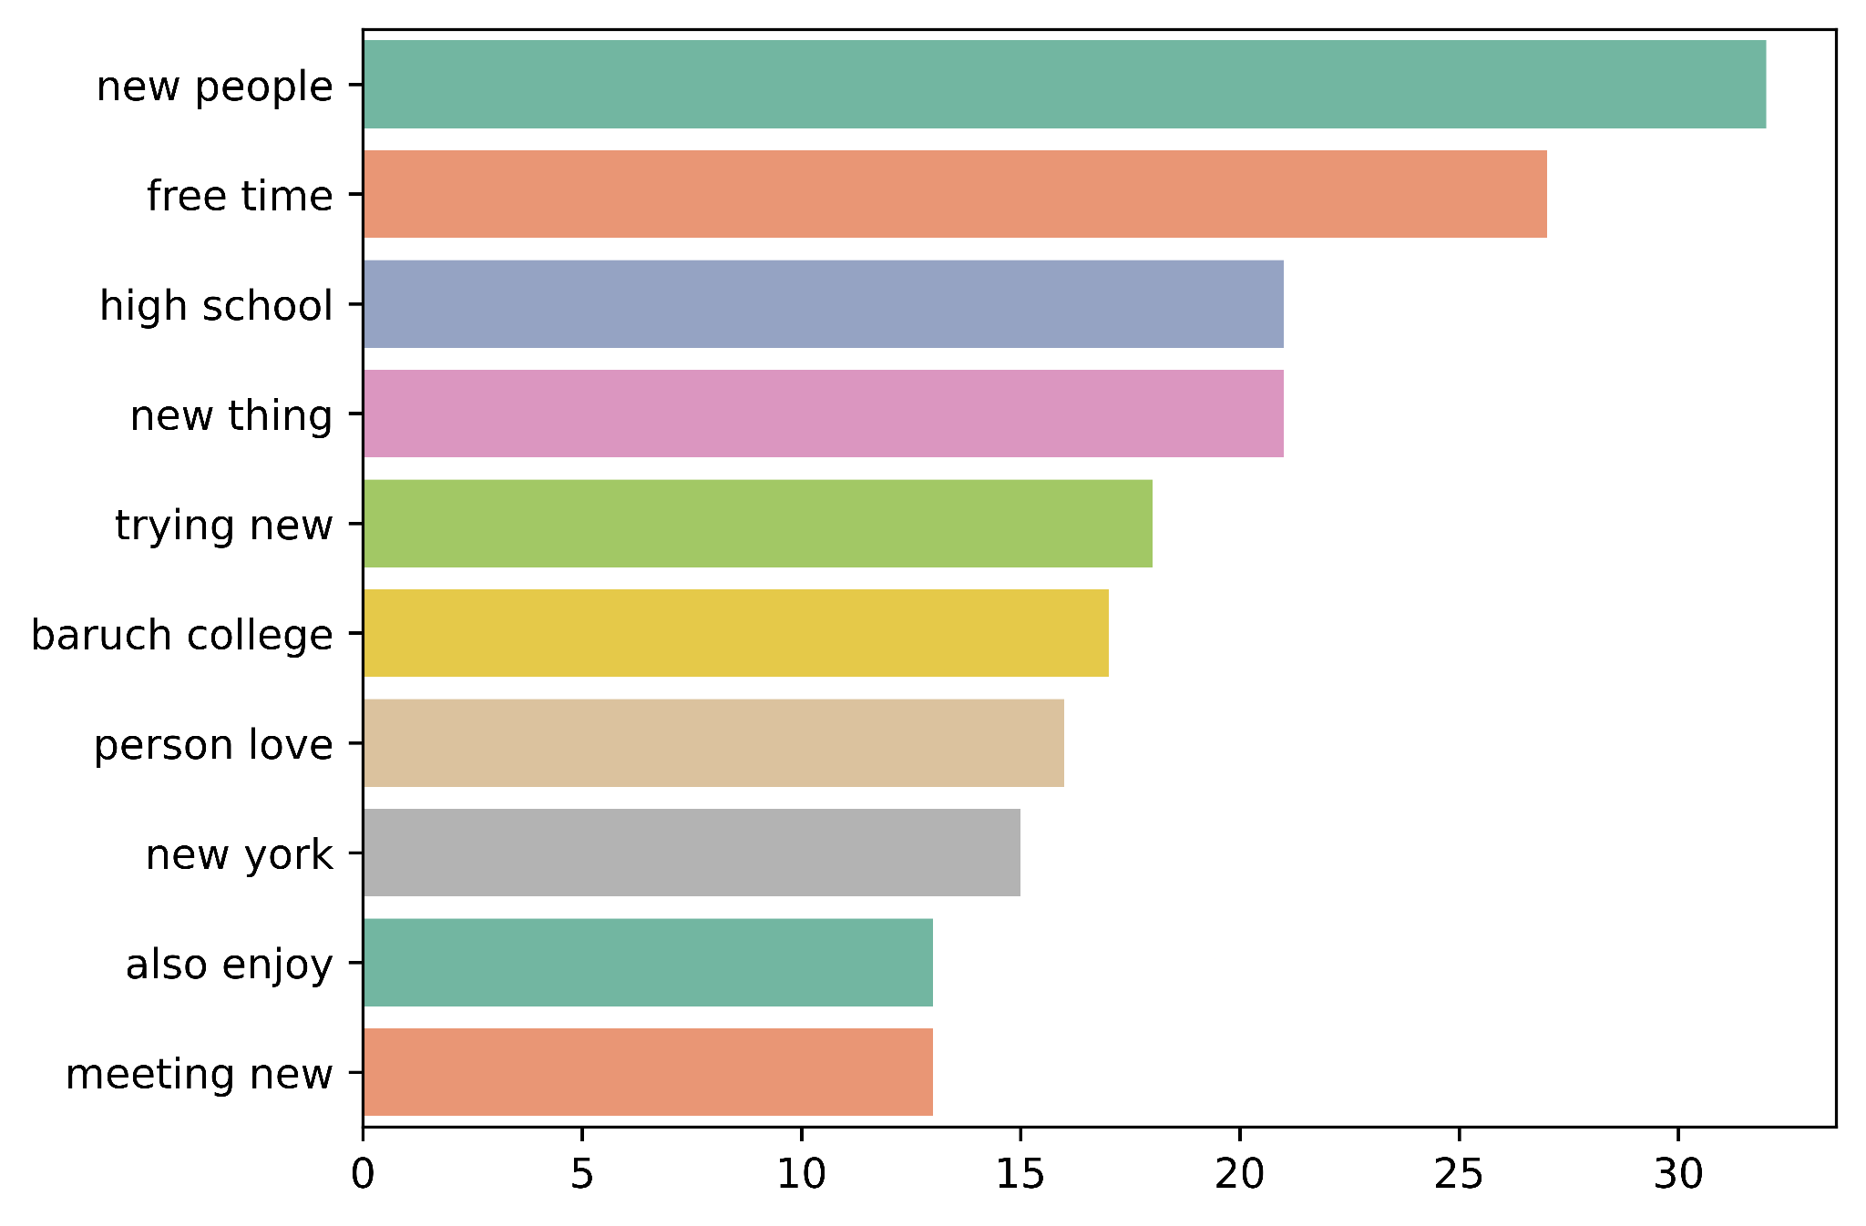
Top Bigrams in the Data
Notes:
Lacy - Most common phrases used by candidates in describing themselves (just to get a sense of what they were writing)
Bar graph: We wanted to take a look at the most common two word phrases from the applicants answers. Most common bigrams that we extracted turned out to be: new people, free time, and high school.

Slide 12
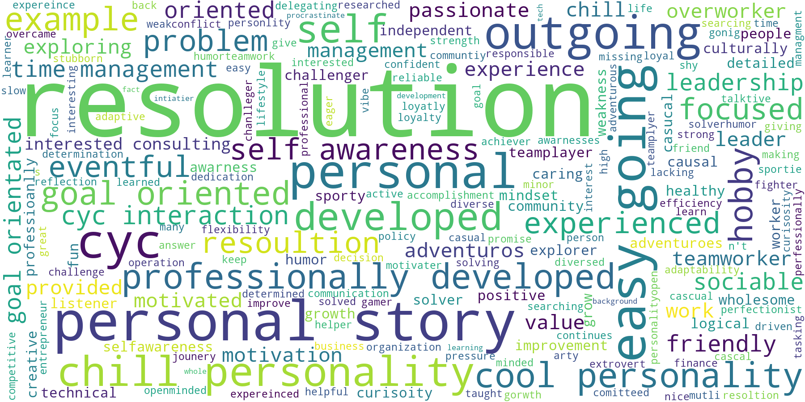
Word Cloud of Accepted to the interview candidates
Notes:
Lacy - This word cloud is for manual sentiment analysis, it was used to identify most common qualities and character traits for the acceptance for an interview
The size of each word display is based on how often the word appears, the more frequently words appear, the larger the font size it have
Possible question: What is resolution

Slide 13
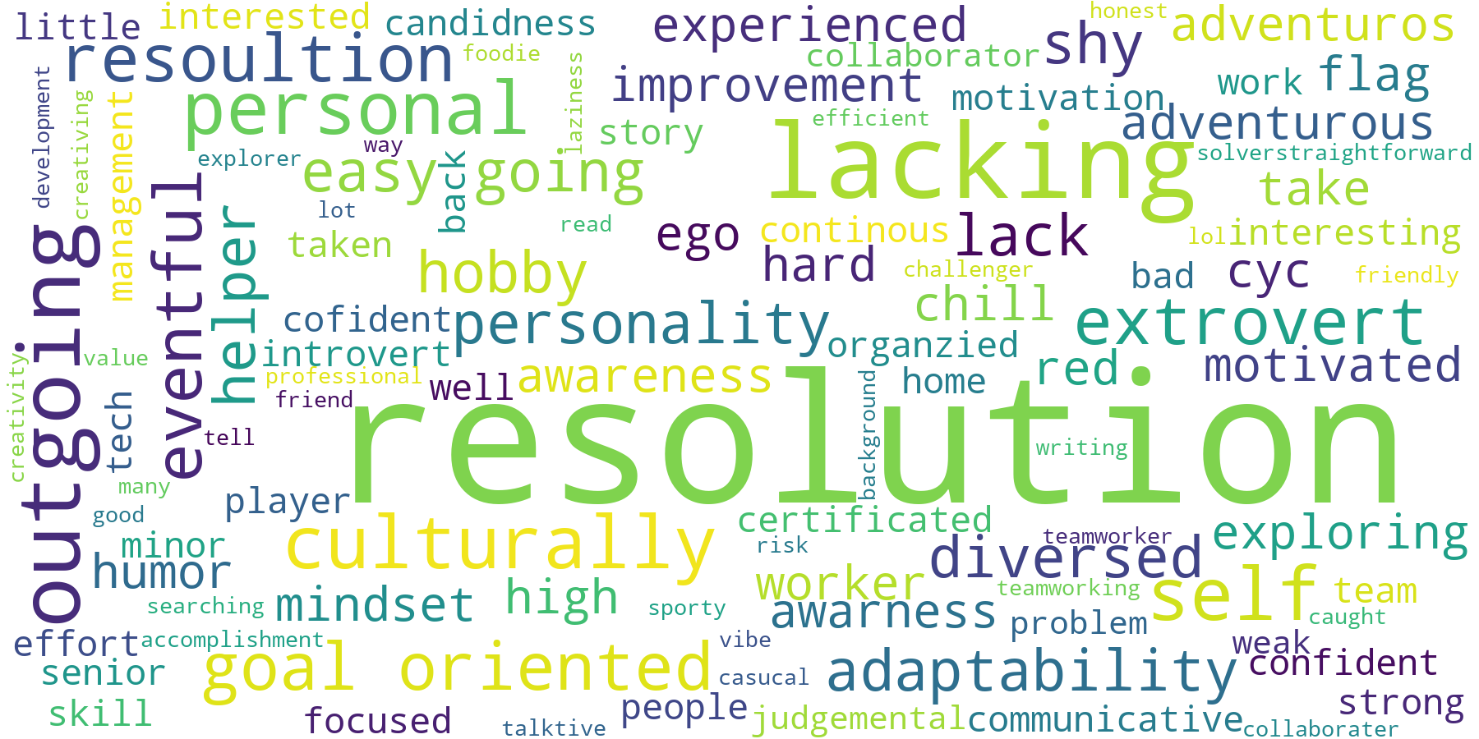
Word Cloud of Not Accepted to the interview candidates
Notes:
Lacy

Slide 14
Data Cleaning and Preprocessing

Slide 15
Preprocessing Textual Data
def preprocess_text(text):
# Check if the text is not NaN (float type)
if isinstance(text, str):
# Use preprocessor to clean the text
cleaned_text = p.clean(text)
# Convert text to lowercase
cleaned_text = cleaned_text.lower()
# Tokenize the text
tokens = word_tokenize(cleaned_text)
# Remove punctuation
tokens = [token for token in tokens if token not in string.punctuation]
tokens = [token for token in tokens if token not in ['``', "''"]]
Formatting
Capitalization, removed urls & emojis
Tokenization
Broke text into individual words or tokens to facilitate further analysis at the word level
Punctuation Removal
Excluded punctuation marks from the text
‹#›
Notes:
Efe

Slide 16
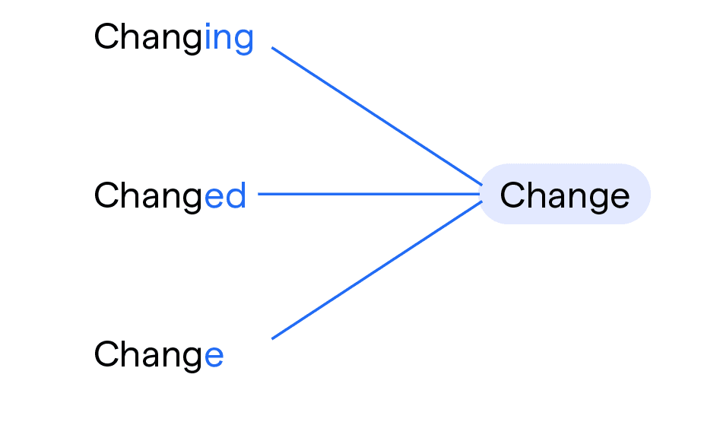
Preprocessing Textual Data
# Remove stopwords
stop_words = set(stopwords.words('english'))
stop_words.discard('no')
tokens = [token for token in tokens if token not in stop_words]
# Lemmatize words
lemmatizer = WordNetLemmatizer()
tokens = [lemmatizer.lemmatize(token) for token in tokens]
# Join tokens back into a cleaned text
cleaned_text = ' '.join(tokens)
return cleaned_text
else:
# Return an empty string or handle missing values as needed
return ' '
Stopword Removal
Removed common words: “the,” “is,” “in,” “for,” “where,” “when,” “to,” “at,” etc.
Lemmatization
Transformed words into their base or root form to ensure consistency in word representation.
‹#›
Notes:
Efe

Slide 17
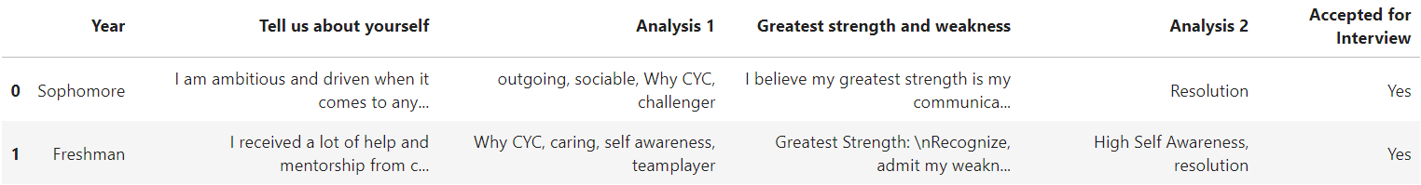
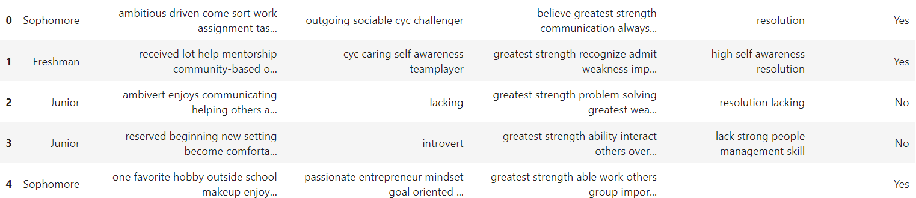
Preprocessing Textual Data
Textual Data before preprocessing:
Textual Data after preprocessing:
Notes:
Efe

Slide 18
Feature Engineering

Slide 19
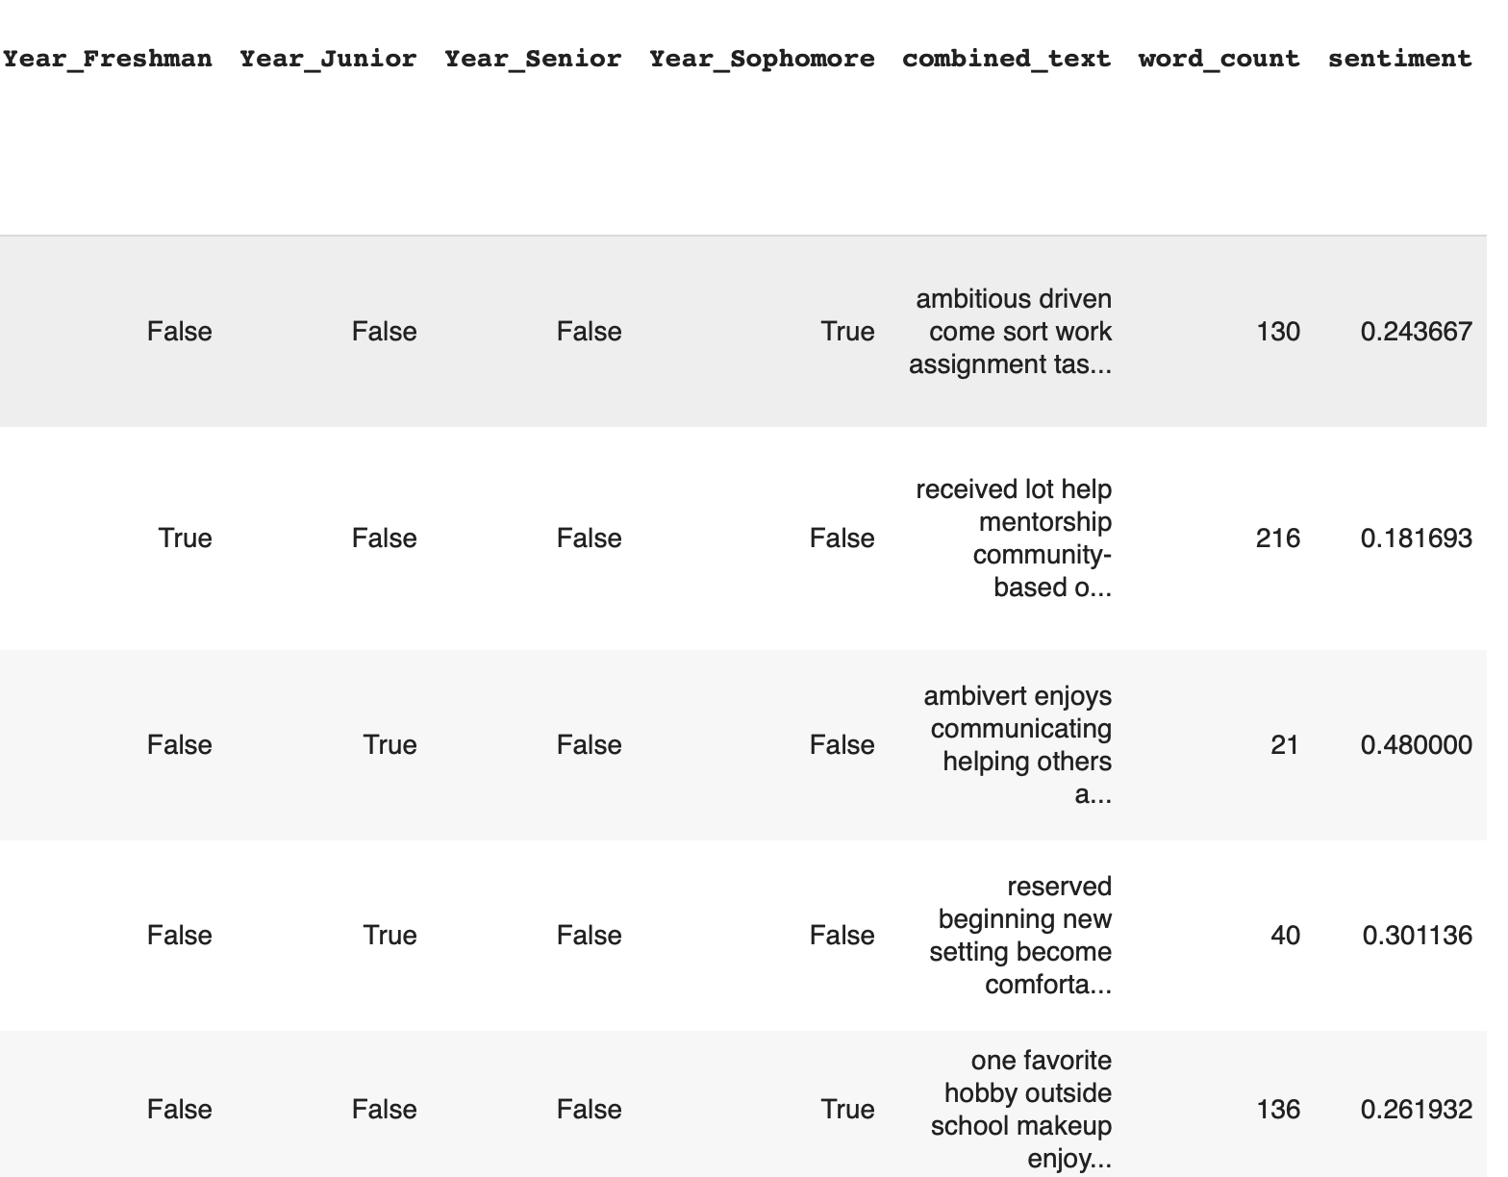
Additional Features added to the Data Frame
One-Hot Encoding
Converted categorical variables into binary vectors.
Utilized pd.get_dummies() in pandas.
Features: Year_Freshman, Year_Senior, etc.
Sentiment Analysis
Assigned sentiment scores to text data.
Utilized sentiment analysis libraries like NLTK
Feature: Sentiment
Word Count
Calculated the number of words in text data
Split text into tokens and counted the tokens.
Feature: Word_count
Notes:
Jae
One-Hot Encoding: Binary
Sentiment: on the combined text (# Polarity: -1 to 1 (negative to positive) # Subjectivity: 0 to 1 (opinion to facts)
I think lemetizing and removing stop words messes up the sentiment analysis. It might be wise to not mention whether we did the sentiment analysis on processed or unprocessed data. If asked, I’d say unprocessed but up to you guys.
Also, we should decide what columns we’re applying sentiment analysis to. To Ricky’s analysis?? If so, then we can’t automate the hiring process, but applying to Ricky’s analysis will probably increase the accuracy more. -Efe
yes : 1 No:0

Slide 20
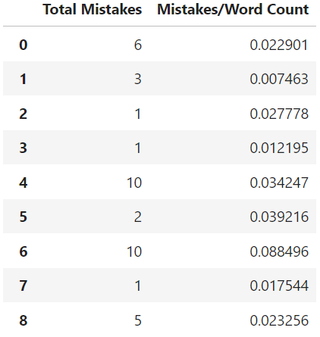
Features that weren’t added
def check_grammar(text):
tool = language_tool_python.LanguageToolPublicAPI('en-US')
# Check the text for grammar mistakes
matches = tool.check(text)
# Return the total number of mistakes
return len(matches)
Total Grammar Mistakes
Utilized the language tool python library to calculate
each applicant’s total grammar mistakes
Total Grammar Mistakes/Word Count
Total grammar mistakes were divided by word count
to account for the linear relationship between word count and total mistakes.
Notes:
Efe

Slide 21
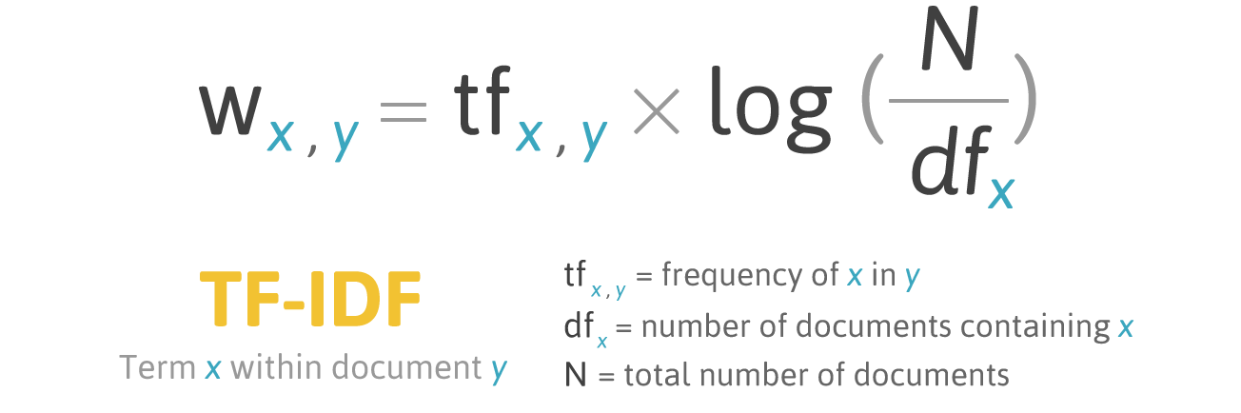
Vectorization
We used term frequency and inverse document frequency (TF-IDF) to transform the raw text data into vectors which can be processed by a machine learning algorithm.
TF-IDF uses term frequency (how important a term is within a document) and inverse document frequency (which reduces the weight of a term if it is common between documents)
Our vectorizer had a vocabulary of 3459 words
Source: Medium
Notes:
Willy
We have to vectorize our raw text data into a vector of numbers before feeding it into our machine learning.
It works by
Using two metrics (term frequency : how many times a word appears in a document
inverse document frequency: assigns a weight indicating how commonly a word is used)

Slide 22
Modeling & Evaluation

Slide 23
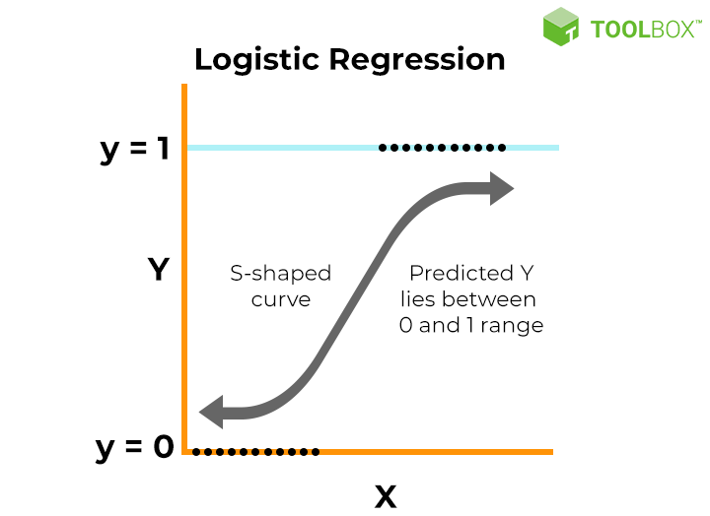
Logistic Regression with textual features
This model estimates the probability that each piece of text (each row in our dataframe) belongs to one of the classes.
Why did we choose this model?
Logistic regression is a common baseline model used for classification problems
Results:
Best hyperparameters | C=10
Average accuracy score after 5-Fold cross-validation: | 0.725
‹#›
Notes:
Kevin - Accuracy alone might not provide a complete picture of model performance, especially in imbalanced datasets where one class is much more prevalent than others. In such cases, other metrics like precision, recall, F1-score, or area under the ROC curve (AUC) might provide a more comprehensive evaluation.
Class- were yes or no
Graph shows the classes
Did grid search to find the best hyperparameters, which is 100
Hyperparameters are “external configuration” variables that are used to manage machine learning model training.
C Parameter: represents the inverse regularization strength. Higher C means lower regularization and vice versa.

Slide 24
Logistic Regression with Numerical Features
Best hyperparameters | C=10
Average accuracy score after 5-Fold cross-validation: | 0.80
Notes:
Kevin
We also performed logistic regression on the numerical features that we engineered in our DataFrame.
Score with numerical feature was ____

Slide 25
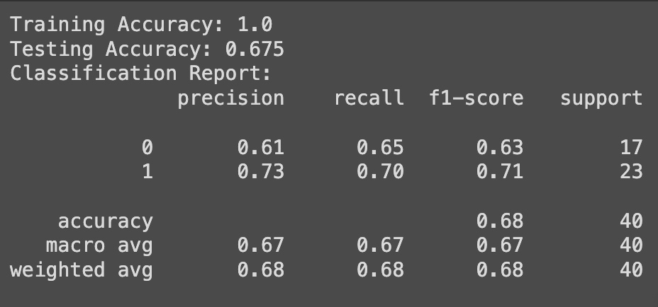
Decision Tree with Textual Features
What is a Decision Tree?
Creating a classification model based on the input data
DecisionTreeClassifier = creates the decision tree model
0 = False, 1 = True
Precision: % of correctly predicted instances
Recall: % of relevant predictions
F1-score: harmonic mean of the precision and recall
Textual Feature: Vectorization
Precision = (True +) / [(True +) + (False +)]
Recall = (True +) / [(True +) + (False -)]
Notes:
Jae
Textual Feature: combined text (strength & weakness, personality)
Explain the difference between precision and recall
Precision: “What proportion of positive identifications was actually correct?”
Denominator: all the positive identifications
Higher precision: fewer false positives (inaccurate)
Recall: “What proportion of actual positives was identified correctly?”
Denominator: all the actual positives
Higher recall: fewer false negatives (inaccurate)
Note that higher recall and precision indicates better performance, but it’s not the only measure of accuracy
Ex: in medical (false positive is better than false negative)

Slide 26
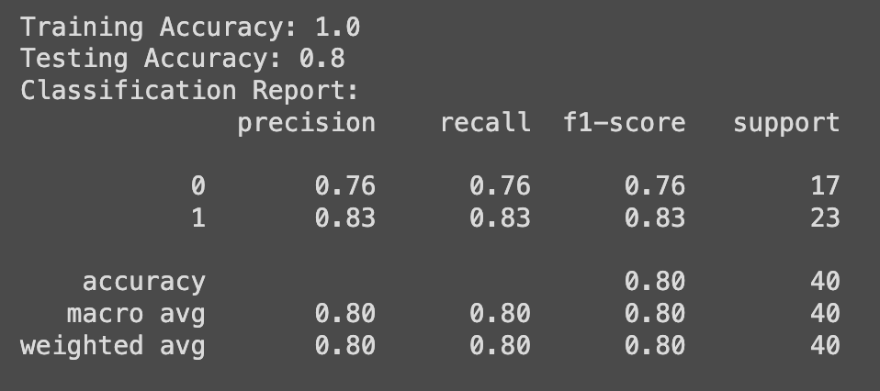
Decision Tree with Numerical Features
Columns: Years, Word Count, Sentiment
Higher Testing Accuracy
Higher Precision
Higher Recall
Higher f1-score
Notes:
Jae
Binary columns: Year and numerical - word count, sentiment

Slide 27
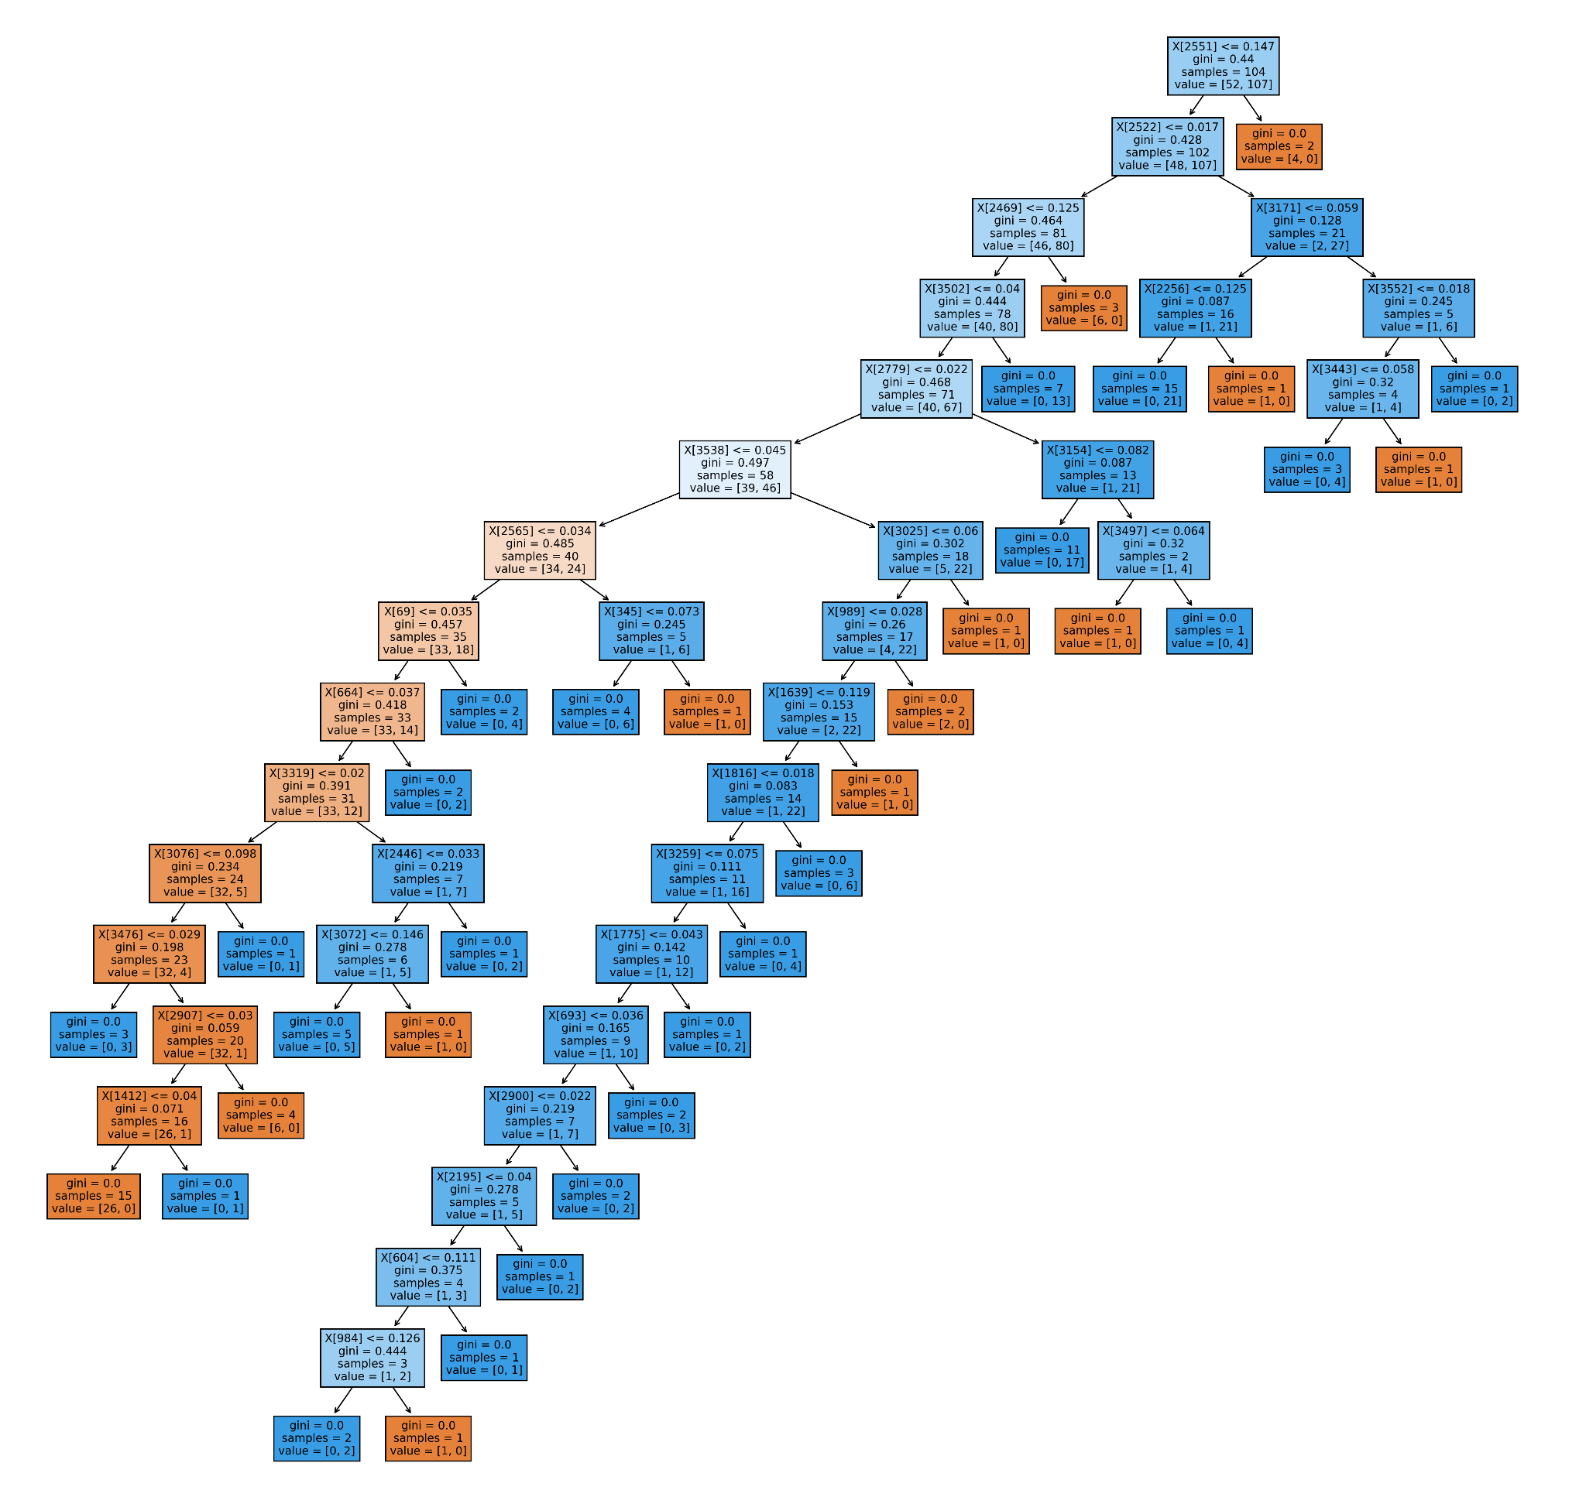
Random Forest with Textual Features
Random Forest is a ensemble learning method of decision trees, which takes the average accuracy of all trees
Parameters: n_estimator =100
Max_depth = 10
Accuracy: 81%
Notes:
Willy
Speak
Advantages of using Random Forest
Increases accuracy from ensembling nature and reduce overfitting
Offers insights into feature importance through measures like feature impurity (gini)
Disadvantages: 1. Interoperability
Note: gridsearch was done to fine the best parameters

Slide 28
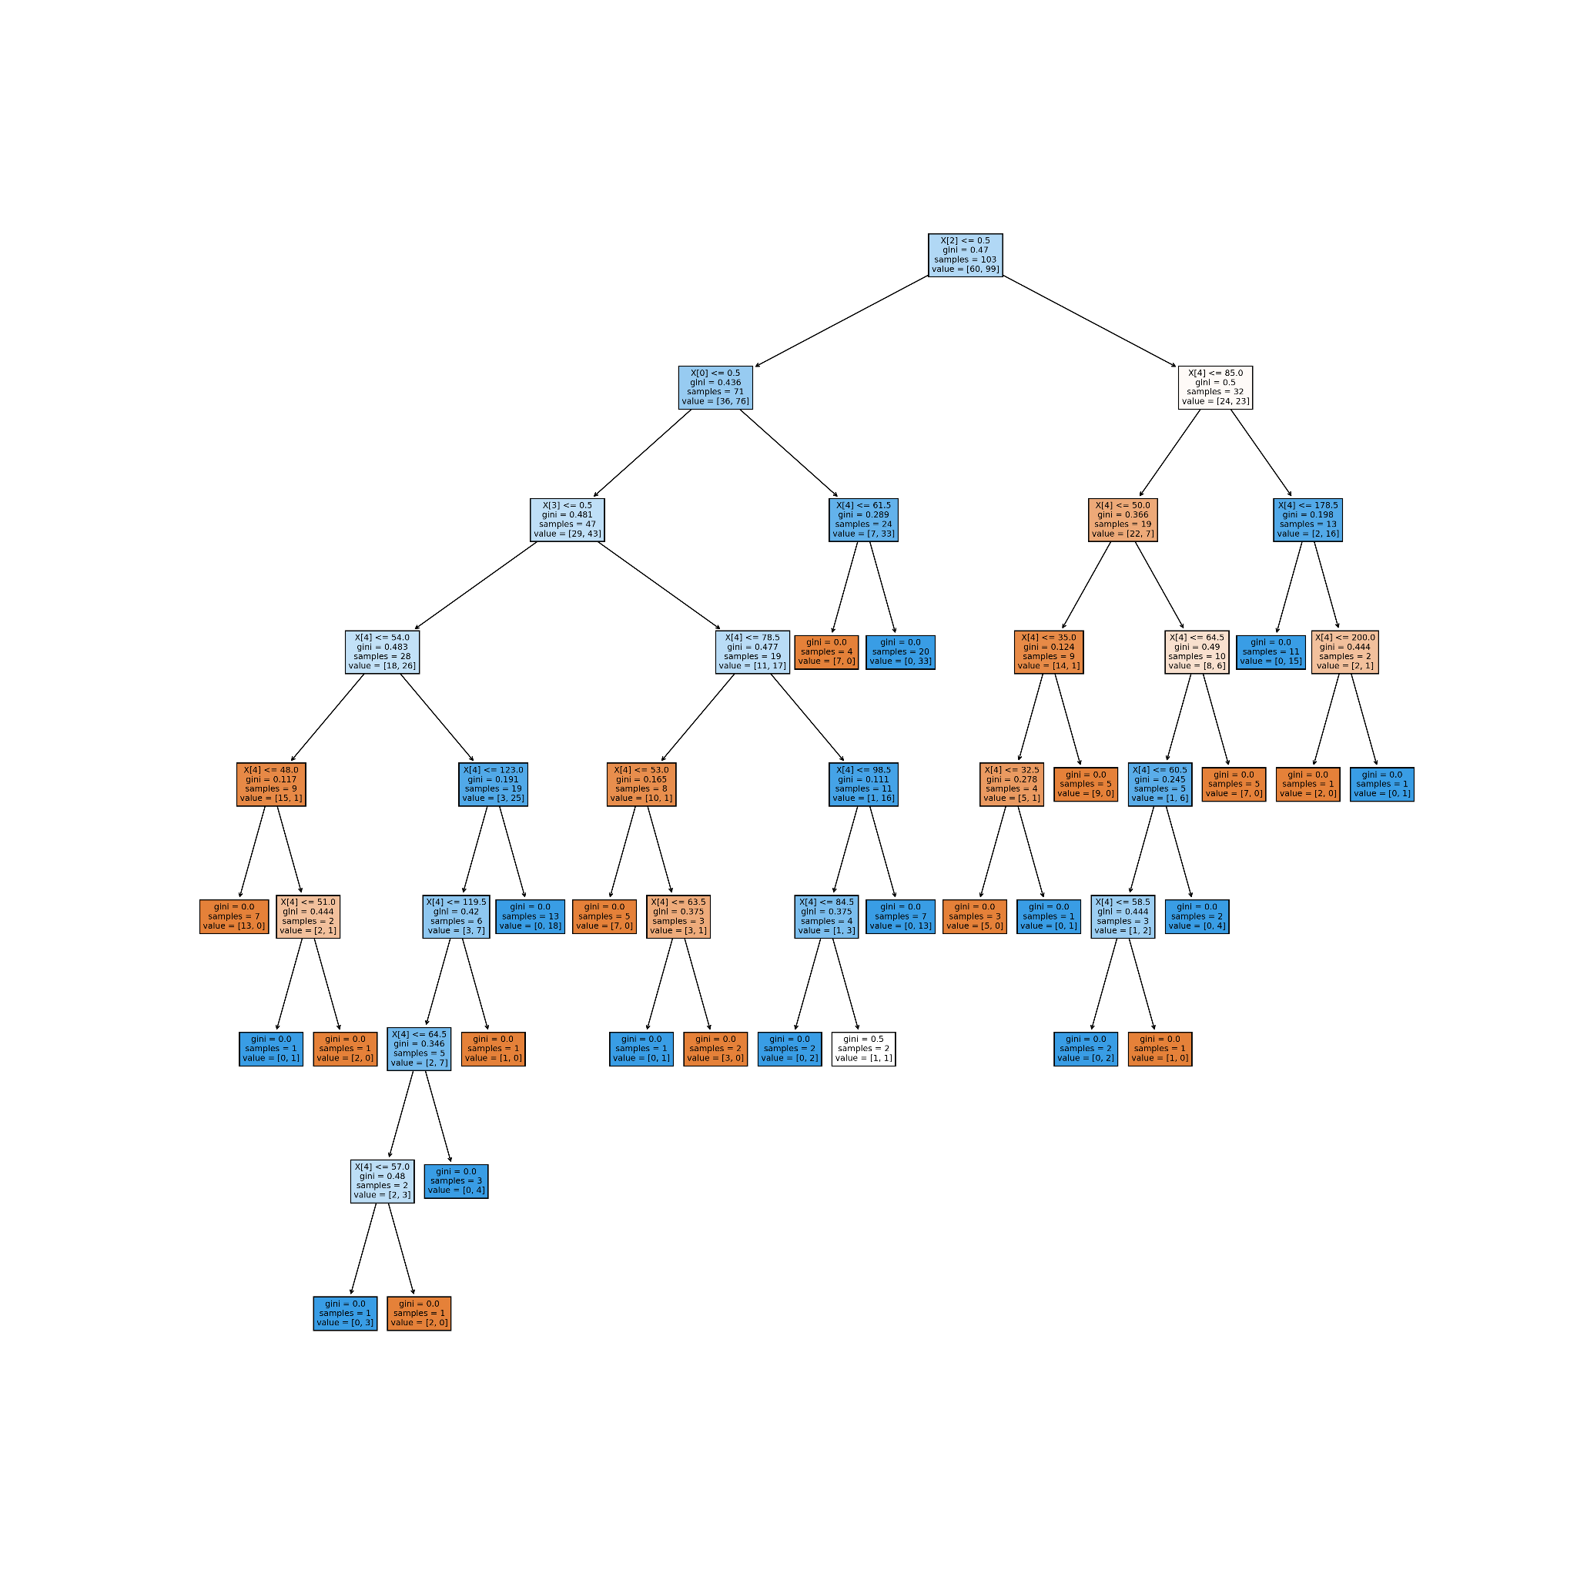
Random Forest with Numerical Features
Parameters: n_estimator =100
Max_depth = 10
Accuracy: 77%
Insights: Our model using textual data performed slightly better than this model.
Notes:
Willy _ The visualization is pretty hard to read
Run gridserach and find best hyperparameters
Note that the random forest model performed better on textual data than numercal

Slide 29
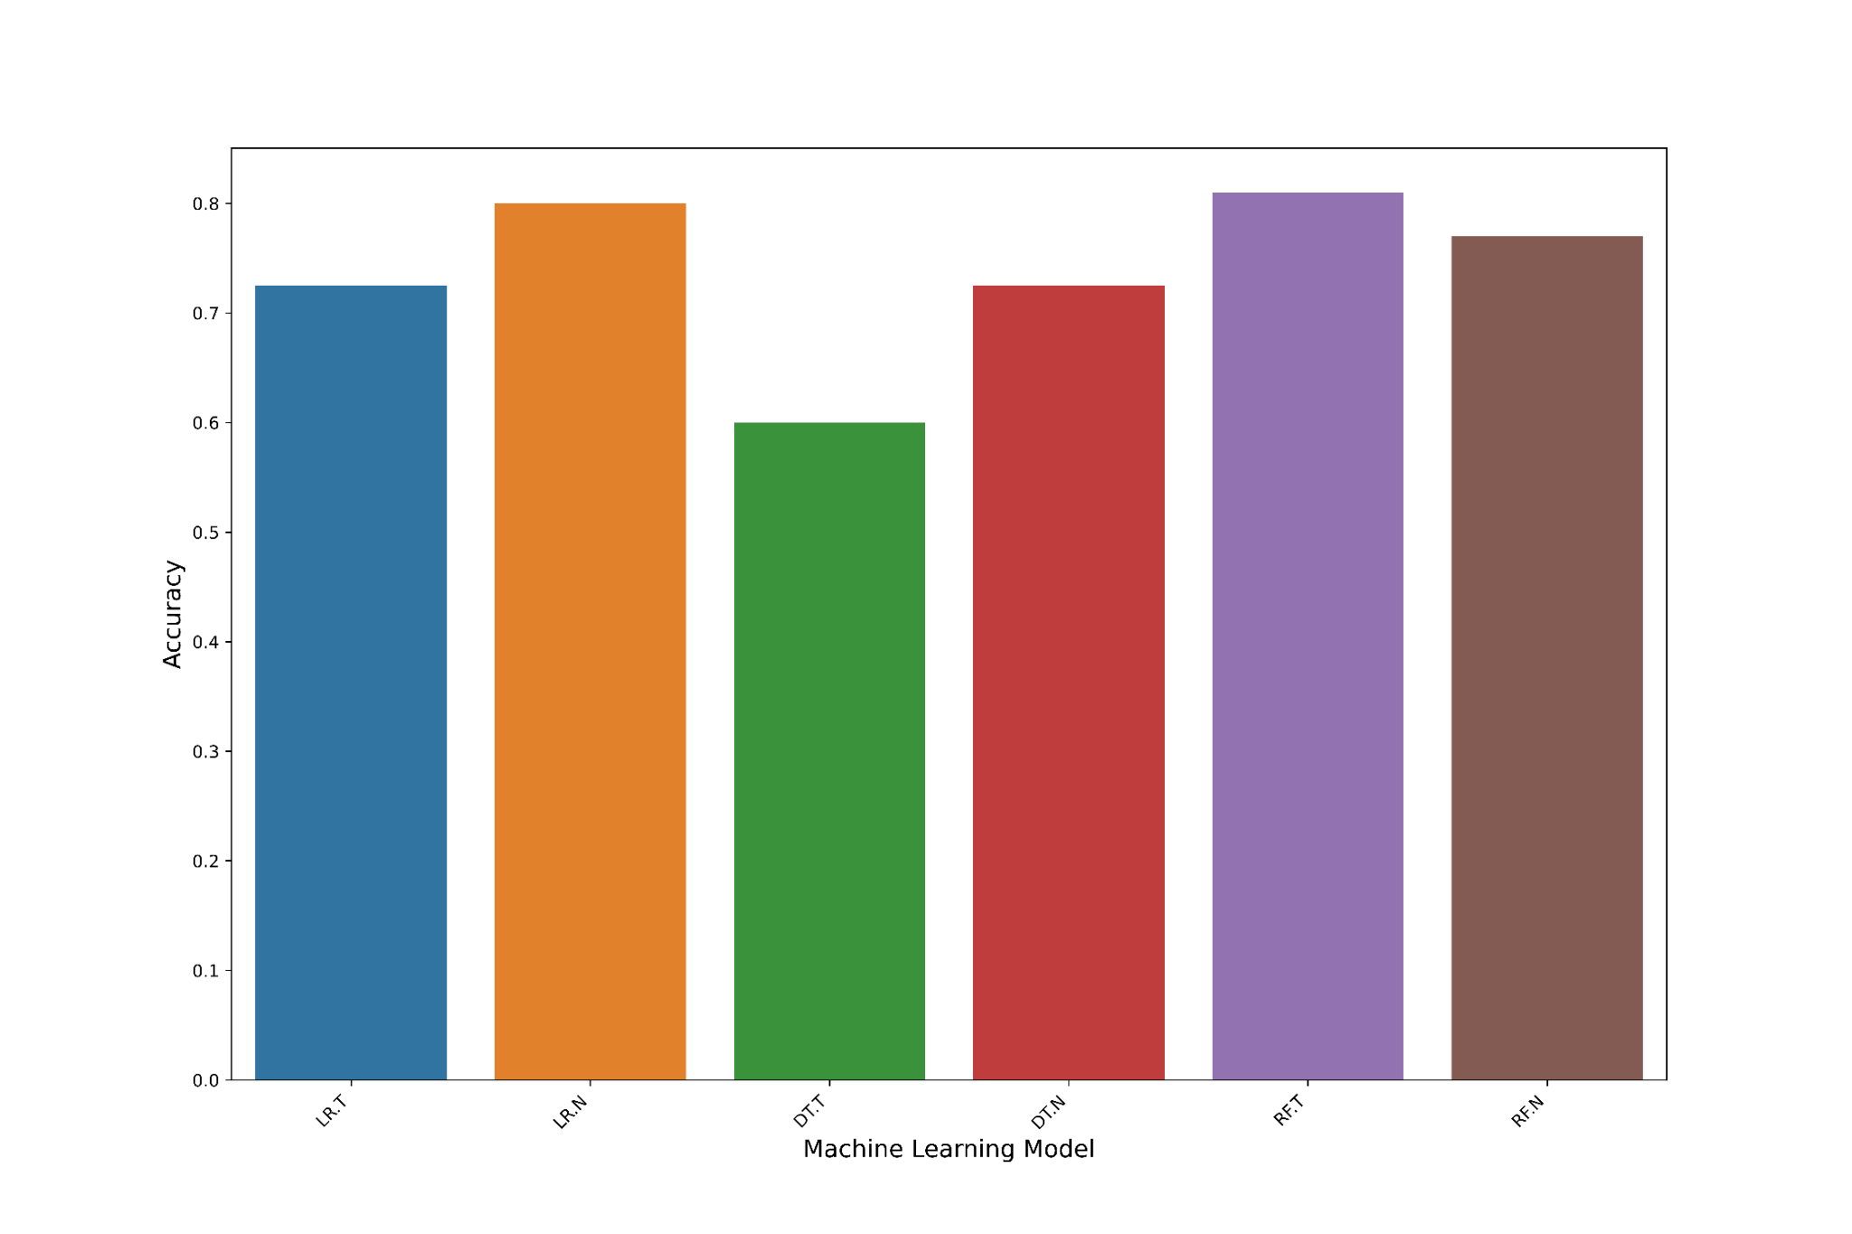
Model Comparison
Notes:
Lacy
Here is the overview of our models. You can see that the highest performing model was Random Forest trained on textual features. And the least performing was Decision Tree also trained on textual features.

Slide 30
Conclusion and Next Steps
Train on more data
Conduct more in-depth data analysis to identify patterns, trends and potential challenges
Conduct more thorough hyperparameter tuning
Diversify model types
Alternative vectorization techniques
Deployment and real-world application
Notes:
Kevin
Steps that we are planning to

Slide 31
Questions?
Notes:
Lacy

